Slide 1
Mars Climate Orbiter
Team Lich
$327.6 million dollar mistake that could have been avoided by some simple Integration testing

Slide 2
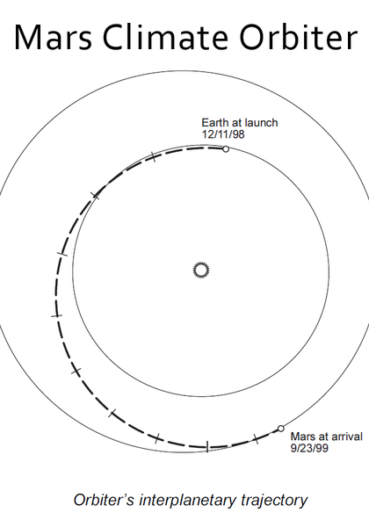
Mission plan
11.12.1998 - Launch at 18:45:51 UTC
23.09.1999 - Orbital insertion maneuver
08:41:00 Insertion begins
08:50:00 – 09:46:00 Preparation and main engine burn start
Main engine burn expected to last for 16 minutes and 23 seconds
09:04:52 Communication with spacecraft lost
09:06:00 Orbiter expected to enter Mars occultation
09:27:00 Expected to exit Mars occultation
25.09.1999 – Mission declared a loss. No further attempts to contact

Slide 3
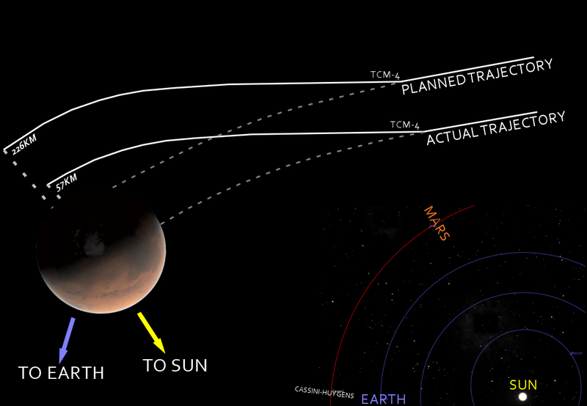
Insertion maneuver goal
The goal of the maneuver is to slow down the spacecraft so it can enter the planets orbit.
To conserve fuel and weight the atmosphere of Mars is used to further slow down the craft into the desired orbit.
In order to achieve that a very sensitive computations must be performed.
That computation was made on the 8th of September. The command was executed on the 15th of September and is known as Trajectory Correction Maneuver - 4.

Slide 4
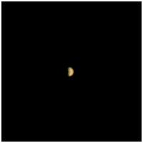
Cause of failure
Failure of Lockheed Martin to follow the Software Interface Specification

